Slide 1
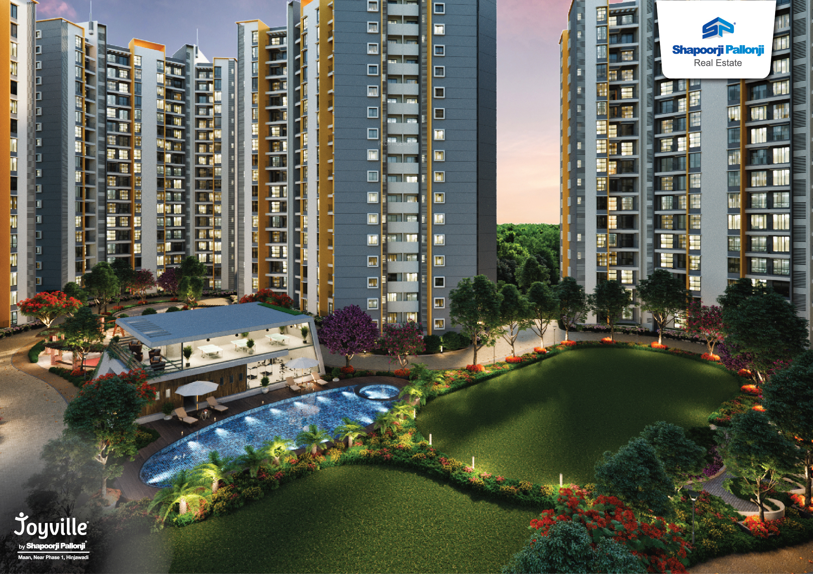
Apartment Manager
Team 3
Leena Bhirud Madhura Jadhav Divya Pai Hrishikesh Tiwari Harsh Nanwani

Slide 2
Agenda
Introduction
Functionality
Entities
ER Diagram
Database Schema
Database Design
Table Creation
Record Insertion
Scenario based SELECT queries
Future Enhancements
Summary

Slide 3
Introduction
Online community portal for resident and staff communication in multifamily housing industry.
Aims to save time, improve efficiency, and build a stronger community with streamline interaction between resident and administrative staff
Currently, the portal offers functionalities for residents to submit a maintenance request, get general announcements, get package and visitor notifications, get inspection schedule details, communicate with fellow residents regarding buying- selling an item, organizing an event and asking for recommendations

Slide 4
Functionality
Maintenance Request
Residents can submit maintenance requests regarding leaks and water damages, appliance repairs, plumbing issues, pest control, etc. Maintenance staff will be assigned to work on these requests. Residents can also keep track of the status of the request with the portal.
Community Wall
Through the Community Wall, residents can post items for sale or rent, ask for recommendations, and organize events. Admin can also use this feature to send broadcast messages about events, specials or alerts to the entire community.
Notifications
Residents will be notified by message/email if their package has arrived or if they have a visitor at the society gate. Residents will get the notification when the package is picked up and can also approve/ reject the visitor entry through this portal.
Inspection Schedule
Admin can schedule half yearly or quarterly inspection for apartments. Residents will get a notification on the portal about details of the inspection visit like date and time, status and result.
Notes:
Divya

Slide 5
Entities
We have identified following entities for our database system:
User (Resident, Admin, Security, Staff are four types of users of the system)
Apartment
Community Wall
Maintenance Request
Notification (Package and Visitor are two types of notifications of the system)
Inspection
Our ER diagram describes all these entities and their relationship with each other in terms of cardinality. The relationship can have one of the following cardinalities: zero or many, one or many, one and only one, zero or one.
Notes:
Madhura
We have identified 6 entities…. List…. User has 4 types and notification has 2 types

Slide 6
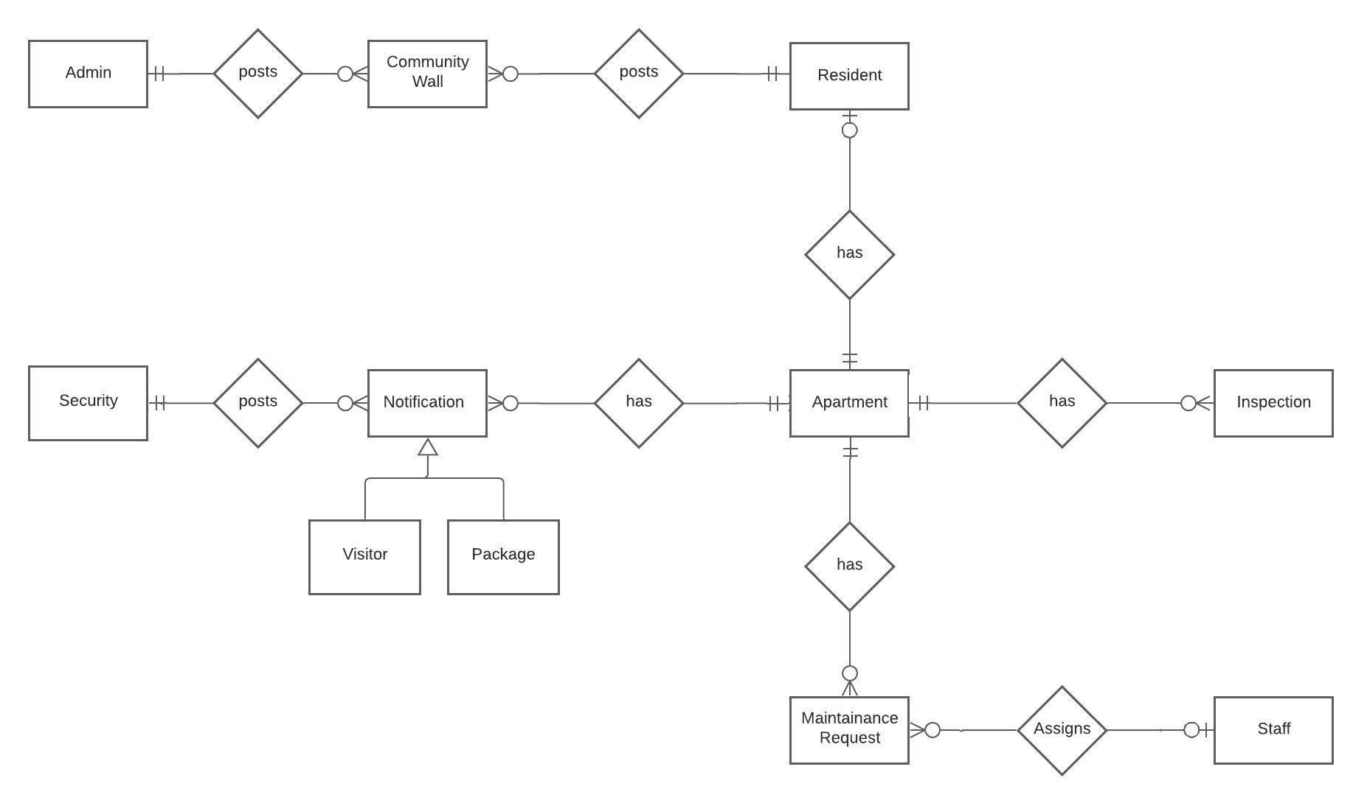
ER Diagram
Notes:
Crowfoot ER diagram
Orange and blue
Start from main entity apartment and cover everything
Explain cardinality
Maintenance Request, Community Wall, Notifications, Inspection Schedule

Slide 7
Database Schema
USER (UId, Name, Email, PhoneNumber, Type)
APARTMENT (ApartmentId, UId, BuildingName, Floor, Configuration, IsVacant)
NOTIFICATIONS (NotificationId, ApartmentId, Timestamp, NotificationText, Status, Type)
MAINTENANCE_REQUEST (ReqId, UId, ApartmentId, Date, Time, Type, Description)
MAINTENANCE_SERVICE (ServiceId, ReqId, Status, Comment, Date ,Time, UId)
COMMUNITY_WALL (PostId, UId,Type, Message, Attachment, Date, Time)
INSPECTION (InspectionId, ApartmentId, InspectionDate, InspectionResult, Status)

Slide 8
Database Design
Database design has been created using MySQL8.0 workbench(MySQL DB)
Provides an efficient, normalized database which allows ease of user interface
To maintain consistency the data has been collected, grouped, and analyzed before performing the data load.
The database is normalized to 3NF after removal of transitive and functional dependencies
Notes:
Hrishikesh

Slide 9
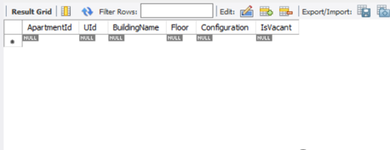
Table Creation
Select query to create an Apartment table,
CREATE TABLE IF NOT EXISTS APARTMENT (
ApartmentId NOT NULL,
UId NOT NULL,
BuildingName NOT NULL,
Floor NOT NULL,
Configuration,
IsVacant ,
PRIMARY KEY (ApartmentId),
FOREIGN KEY (UId)
REFERENCES USERS (UId)
ON UP RESTRICT ON DELETE CASCADE);
Similarly other tables have been created.
Apartment table schema/ Data definition
Notes:
lets take example of creation of master table Apartment
if not exists is used before creation of the table to check whether the table is available in the system or not
upon execution of the query database table is created which is mentioned at the right side of the slide

Slide 10
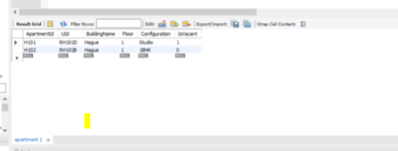
Record Insertion
Data insertion using Insert statement,
INSERT INTO APARTMENT (
ApartmentId, Uid, BuildingName, Floor, Configuration, IsVacant)
VALUE('H101', 'RH101D', 'Hague' ,'1', 'Studio', true),
('H102', 'RH102B', 'Hague', '1', '1BHK', false);
Other way to perform insertion is maintain data in excel and upload the same to database by creating .CSV file
Notes:
continue the same example for insertion ,
Rest of the tables record upload have been done using .csv file upload

Slide 11
Scenario Based Select Queries
Scenario:
Here, once front desk receives a package from the courier, admin user will search for an apartment number.
Upon finding valid details, admin user clicks on notify button. Upon clicking, new entry will be inserted in NOTIFICATIONS table and the resident user will get notification via email and text message for pick-up.

Slide 12
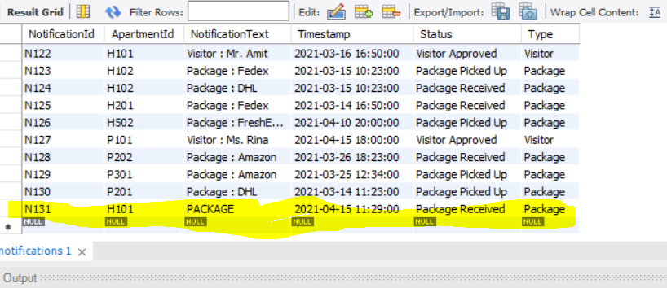
Sample Query
INSERT INTO NOTIFICATIONS (NotificationId,ApartmentId, NotificationText, Timestamp, Status, Type) SELECT 'N131', 'H101','PACKAGE', '2021-04-15 11:29:00’, 'Package Received','Package'
FROM USERS AS U
INNER JOIN apartment as A
WHERE U.UID = A.UID
AND A.APARTMENTID = 'H101'; (User input from front end)

Slide 13
...Scenario Based Select Queries
Scenario:
If a resident wants to sell an item, for example, an office desk, s/he can create a post on the community wall. Upon clicking POST button on User interface, request gets posted.
Notes:
you can right click on attachment of specific record and select open in editor to see the image at back end . once the request posted on community wall user can see the details (for that we need to write the query to select the image and display at front end )

Slide 14
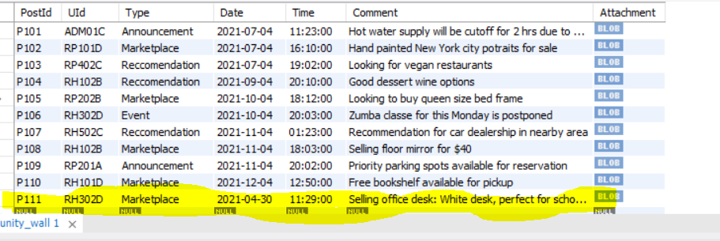
Sample Query
INSERT INTO COMMUNITY_WALL (PostId, UId, Type, Date, Time, Comment, Attachment) SELECT 'P111', 'RH302D','Marketplace', '2021-04-30’,'11:29:00’, 'Selling office desk: White desk, perfect for schoolwork or at home office! In great condition! ‘, 'D:\LeenaPace\IS613\Project\Study_table.JPG’ FROM USERS AS U
INNER JOIN COMMUNITY_WALL as A
WHERE U.UID = A.UID
and U.UID ='RH302D'; (User input from front end)
Notes:
lets take example of creation of master table Apartment
if not exists is used before creation of the table to check whether the table is available in the system or not
upon execution of the query database table is created which is mentioned at the right side of the slide

Slide 15
Future Enhancements
This portal can be enhanced incorporate variety of functionalities improving the resident and staff experience.
Online rent payments, bill payments and renter's insurance
Lease signing and renewal
Apartment availability
Amenity and space reservation
Access to services like cleaners, dog walkers, childcare and more
Complaint form and surveys
Advertising space for promotions and announcements
Integration with existing property management solutions
Customization of portal based on client’s property branding
Notes:
Harsh

Slide 16
Conclusion
An Apartment Manager System that helps ease communication between administrative staff and residents digitally
Minimizes human effort and increases efficiency of operations
Now that our database system is fully functional and optimized, we can start our front-end using angular or react framework
We can start building our customizable APIs by using Python web frameworks such as Django or Flask
Notes:
Harsh

Slide 17


